Slide 1
B TREES
TEAM CCLEX
MEMBERS
Wayne Matthew Dayata
Hannah Ruth Labana
Ivan Ric Woogue
Marc Nathaniel Valeros

Slide 2


Who are the proponents of B-trees?
In 1972, Rudolf Bayer and Edward M. McCreight, both computer scientists, invented a data structure called “B-trees”
"Organization and Maintenance of Large Ordered Indexes”

Slide 3
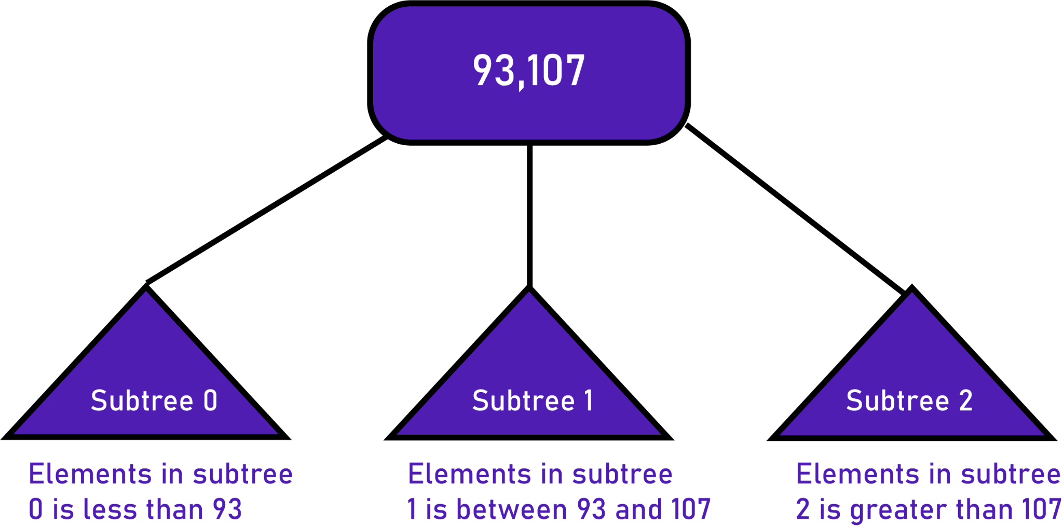
Why did they invent B-trees?
To access and maintain efficiently an index that is too large to hold in memory.
B-trees are a way to get better locality and limit the number of seek operations
Accessing a disk location takes about 5ms = 5,000,000ns, thus an efficient algorithm is needed.

Slide 4
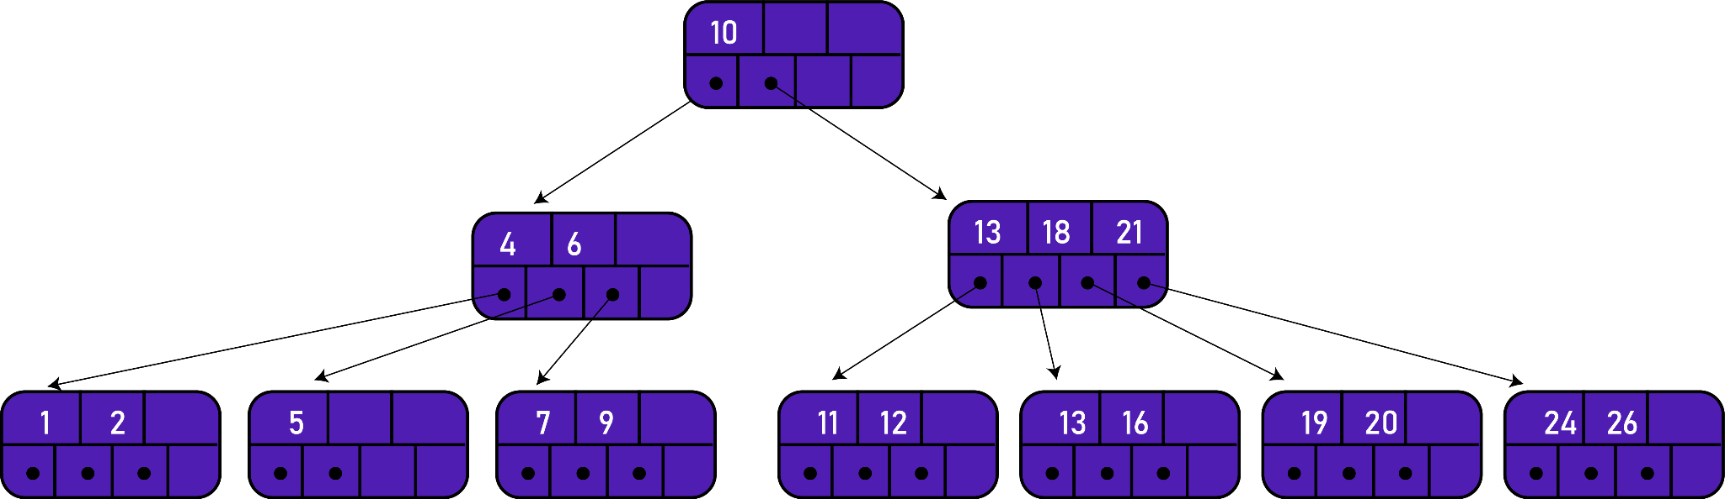
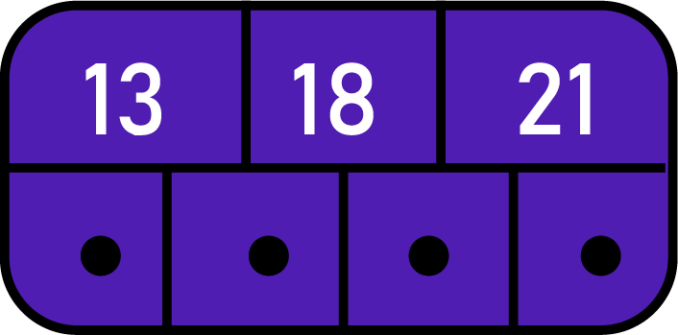
TERMS
01
Page or node
02
Order of B-tree
consists of an ordered sequence of keys and a set of pointers.
represents the upper bound on the number of immediate children a B Tree can have.
What is the order?
4
How many pages?
10

Slide 5
TERMS
03
Internal nodes
04
Leaf nodes
all nodes except for leaf nodes and the root node.
considered to be the lowest level of keys and the pointers do not lead to other pages(points to null)

Slide 6
CONCEPTS
A B-tree is a self-balancing tree data structure that keeps data sorted and allows searches, insertions, and deletions in logarithmic amortized time.
Time complexity to search, insert and delete is O(Log_{M} n) .
It is most commonly used in database management systems (DBMS) and file systems.

Slide 7
CONCEPTS
The height of B-Trees is kept low by putting maximum possible keys in a B-Tree node.
1,5 ,8,9,12,19,21,23,25,27,29,35,41,43,44,49,57,65,72
Let’s insert the values above in a B-tree of orders 5 & 7. Notice the height and distribution of the keys.

Slide 8
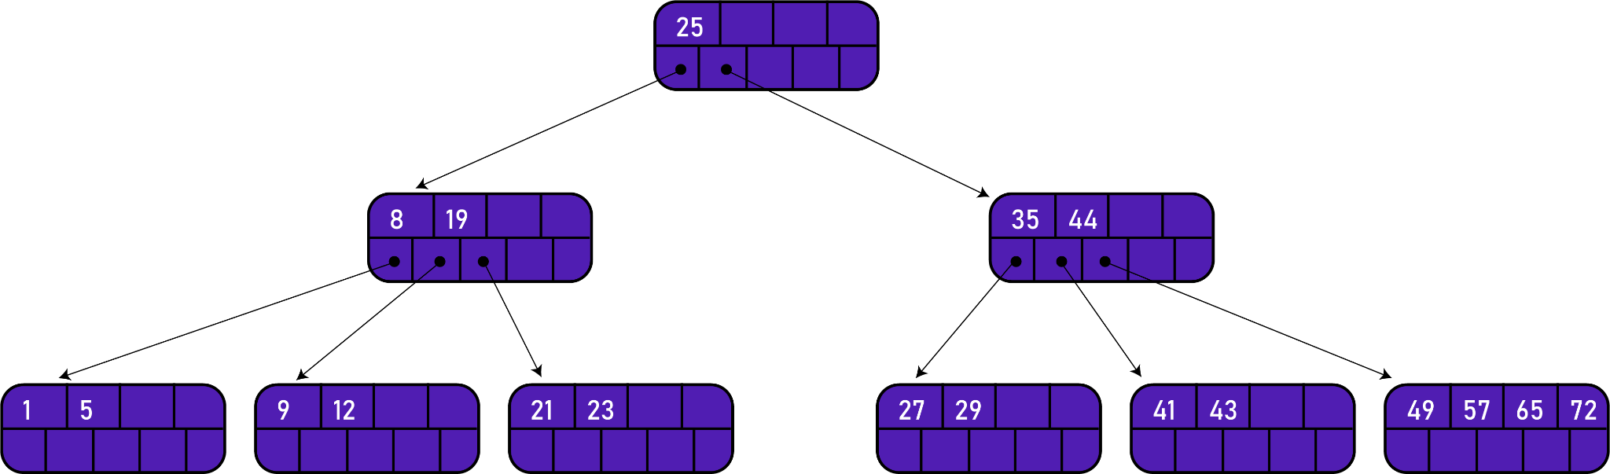
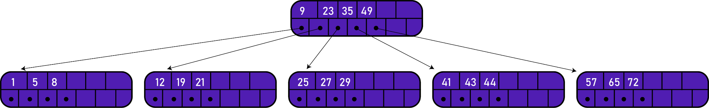
ORDER 5
ORDER 7
What are your observations?

Slide 9
Properties of a B-tree of order m:
Every page has a maximum of m descendents.
Every page, except for the root and the leaves, has at least m/2 descendents.
The root has at least two descendents.
All the leaves appear on the same level.
A non leaf page with m descendents contains m - 1 keys.
A leaf page contains at least (m/2) - 1 keys and no more than m - 1 keys.
All the key values within a node must be in ascending order.

Slide 10
Key Comparisons
Basis for Comparison | B-TREE | BINARY TREE
Essential constraint | A node can have at max M number of child nodes(where M is the order of the tree). | A node can have at most 2 children.
Usage | It is used when data is stored on disk. | It is used when records and data are stored in RAM.
Height of the tree | logM N (where m is the order of the M-way tree) | log2 N
Application | Code indexing data structure in many DBMS. | Code optimization, Huffman coding, etc.

Slide 11
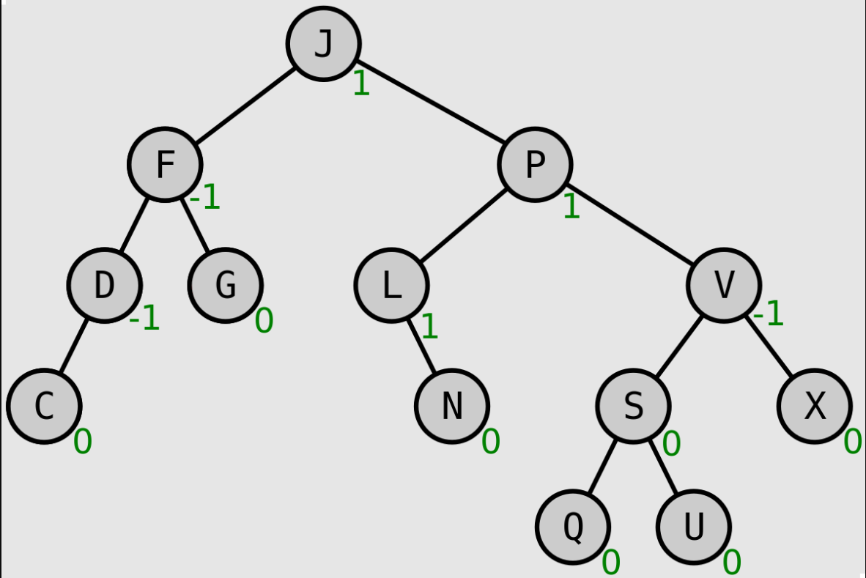
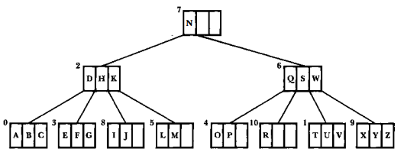
Binary Search Tree/AVL Tree vs B-Tree
On what direction does each of the trees grow?
How does this affect the search length of the tree's elements?
Are the access times consistent?

Slide 12
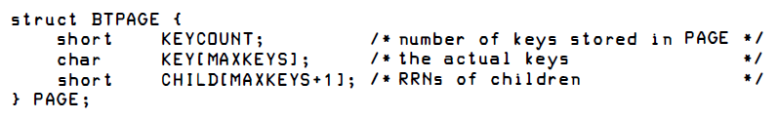
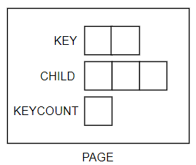
Original Version
What is this representing?
How do you define the data structure?
Source: File Structures (Second Edition) by Folk, Zoellick
Notes:
(start with a node/page, naay keys and pointers in between)
- need a keyCount to identify how many keys - b tree flexibility - naay #define Max to determine max keys per page (the order)
- simulate what happens if a page is full - splitting and promotion
- add to the data structure nga array of pages, and a field to signify the head, then clarify that the pointers means the page to continue the lookup

Slide 13
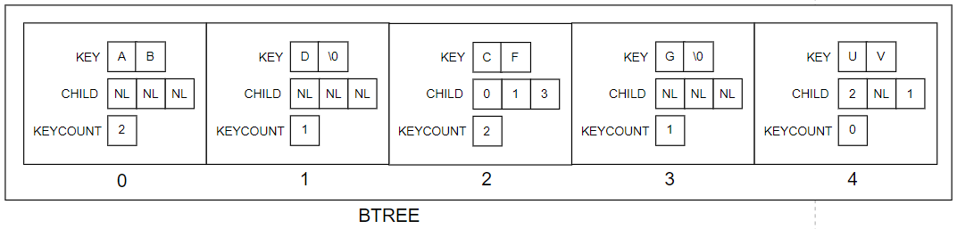
Original Version
#define MAXKEYS 2 // order of the B-Tree is 3
#define NL -1 // sentinel value for no child
#define MAX 5 // maximum pages will be 5
struct BTPAGE BTREE[MAX];
............ // statements to initialize and put some values in BTREE
Source: File Structures (Second Edition) by Folk, Zoellick
Notes:
(start with a node/page, naay keys and pointers in between)
- need a keyCount to identify how many keys - b tree flexibility - naay #define Max to determine max keys per page (the order)
- simulate what happens if a page is full - splitting and promotion
- add to the data structure nga array of pages, and a field to signify the head, then clarify that the pointers means the page to continue the lookup

Slide 14
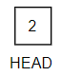
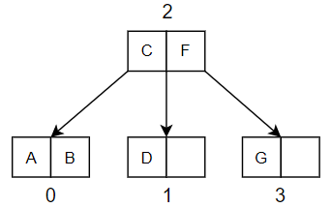
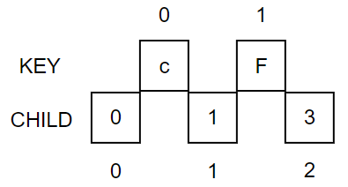
Original Version
Source: File Structures (Second Edition) by Folk, Zoellick

Slide 15
Operations in B-Tree
Search
Insert
Delete
Additional actions in B-Tree
Splitting
Promotion
Redistribution
Concatenation
More on these in our simulations ☺

Slide 16
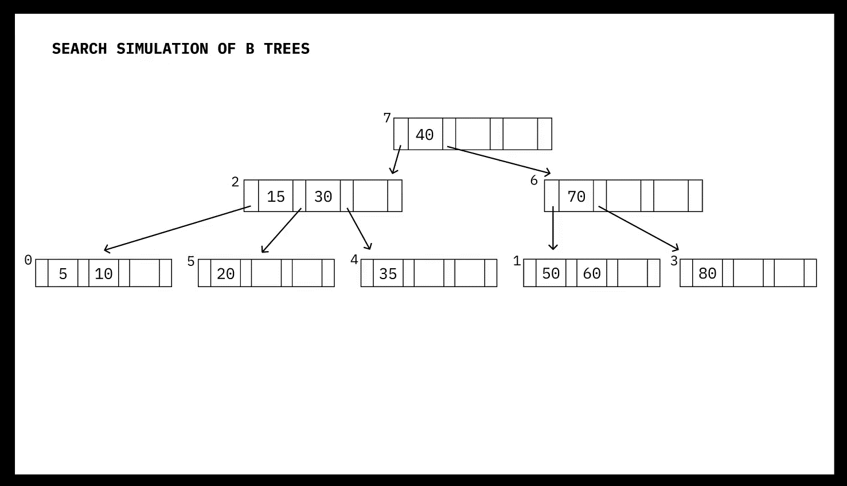
Search Simulation

Slide 17

Insertion Simulation

Slide 18
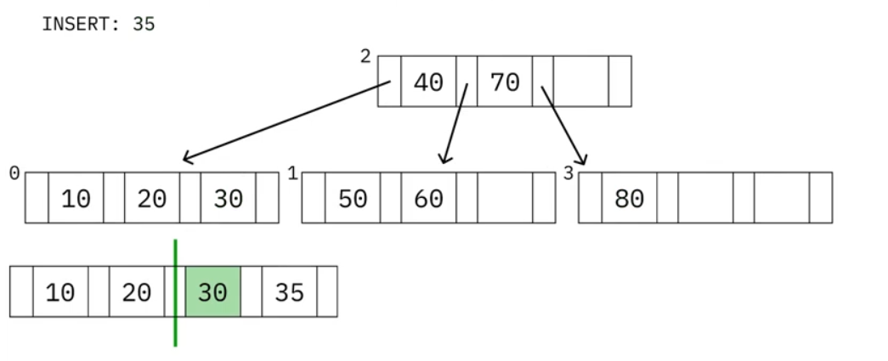
Insertion: Observations
Begins with a search that proceeds downward from the root to the leaf level.
After finding the insertion location at the leaf level, the work of insertion, splitting, and promotion proceeds upward from the bottom.

Slide 19
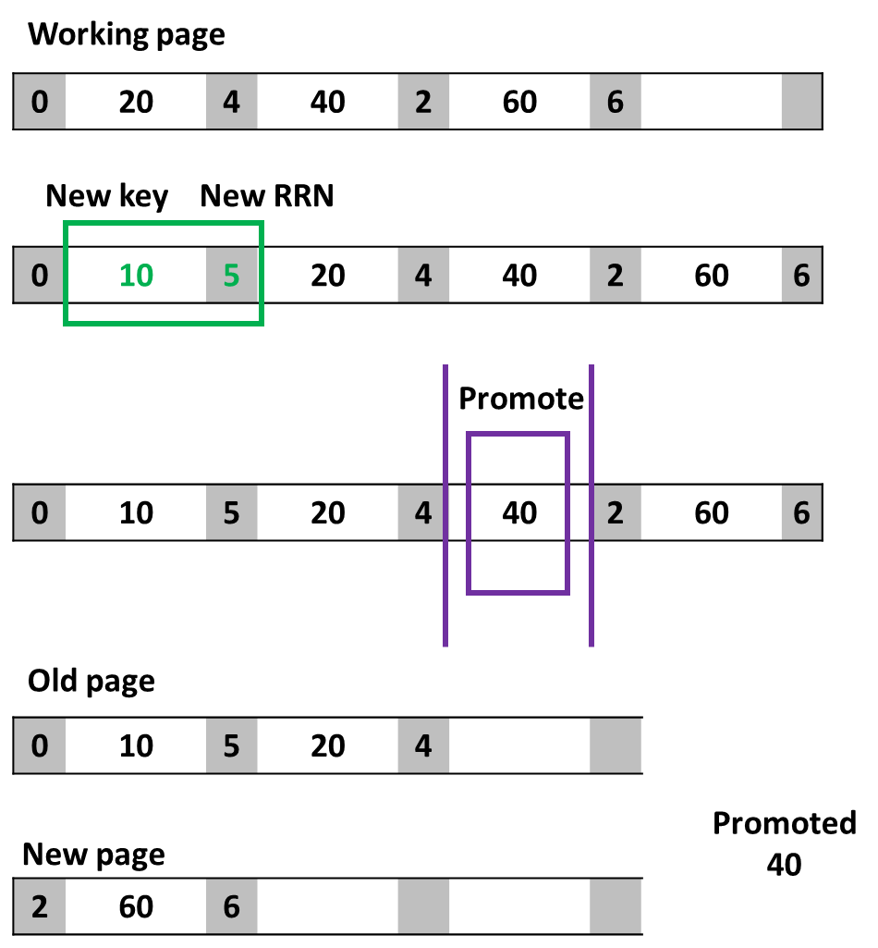
Splitting and Promotion
Original page
Prepare a working page
Must hold an extra key and child pointer.
Copy the contents from the original page to the working page.
Insert the new key and its RRN into the proper position of the working page.
Promote the middle key to the parent page.
Place contents to the left of the middle key back to the original page.
Place contents to the right of the middle key into a new page.
Note the new page's RRN.

Slide 20
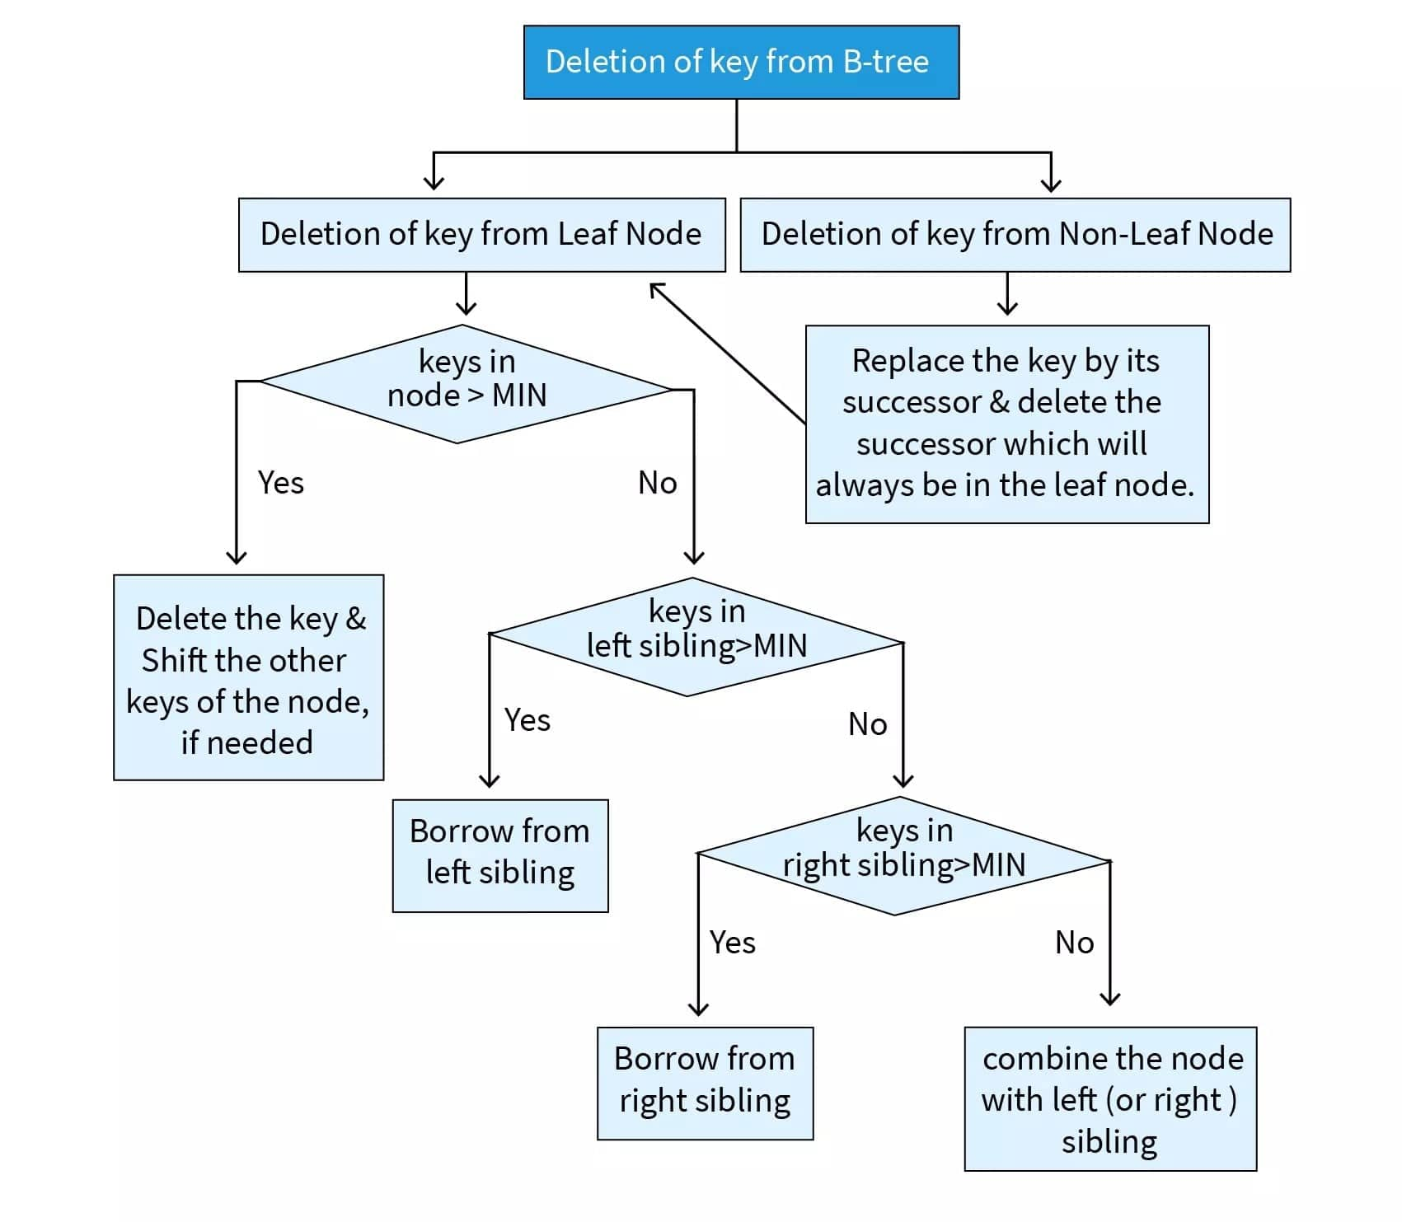
Deletion: Classification of cases
MIN = ⌈m/2⌉- 1
Replacement of successor
Shifting
Redistribution
Concatenation
Which among the processes are similar to that in binary search tree?
Check if parent node reaches MIN

Slide 21
Deletion Simulation
(Refer to attached PPT for the simulation)

Slide 22
Original Version
Common characteristic between the searching, inserting, and deletion operations
Recursive due to the subtasks:
Splitting and promotion
Redistribution and concatenation
And these 4 additional operations happen on the way up.
Source: File Structures (Second Edition) by Folk, Zoellick

Slide 23
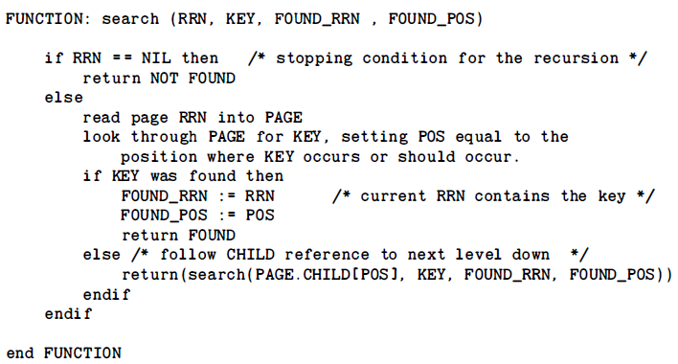
Original Version
Notes:
1. Return type can be an enum (FOUND, NOT_FOUND)
2. Very similar to searching in binary trees
Source: File Structures (Second Edition) by Folk, Zoellick

Slide 24
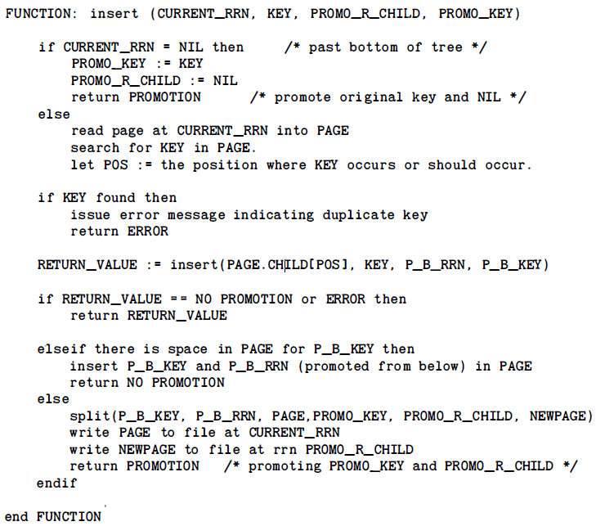
Original Version
Notes:
1. Insertion will always be done on the leaf
2. Return type can be an enum (PROMO, NO_PROMO, ERROR)
3. Duplicate keys are not allowed
4. Update root pointer when necessary
5. Sort the page where key is inserted using inner loop of insertion (O(n))
Source: File Structures (Second Edition) by Folk, Zoellick

Slide 25
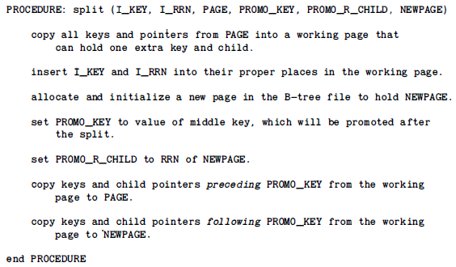
Original Version
Notes:
1. A working page with extra 1 key and child is created
2. Insert the key and its RC if it exists from previous call in its correct position
3. Median key is promoted
4. The new page is the right child of the promoted key
Source: File Structures (Second Edition) by Folk, Zoellick

Slide 26
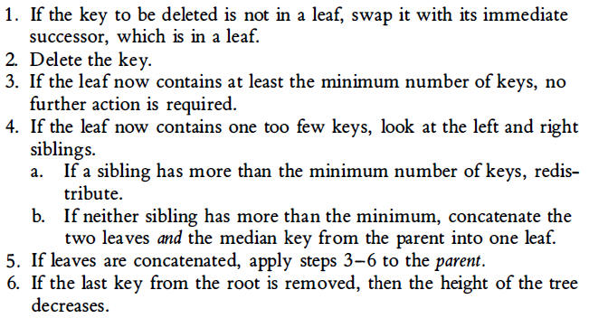
Breakdown of Original Version
Delete
Notes:
1. Deletion always happens on the leaf
2. If not on leaf, swap with immediate successor
3. Underflow - leaf contains less than minimum number of keys
(⌈ m/2 ⌉ - 1)
4. Decrease key count.
Ways of dealing with underflow:
1. Redistribution
2. Concatenation
Source: File Structures (Second Edition) by Folk, Zoellick

Slide 27
Original Version
Redistribution (POV of the parent)
Notes:
1. There is an underflow.
2. It is assumed there is a child that has more than the minimum number of keys (⌈ m/2 ⌉ - 1)
Promote the median (n/2) key of the child where the key was not deleted as the new parent
If it is a left child where the key was deleted
Append the ff keys to the left child in order (left to right)
Parent key
All keys to the left of the median of the right child
If it is a right child where the key was deleted
Prepend the ff keys to the right child in order (from left to right)
All keys to the right of the median of the left child
Parent key
Source: File Structures (Second Edition) by Folk, Zoellick

Slide 28
Original Version
Concatenation (POV of the parent)
Notes:
1. There is an underflow.
2. It is assumed there is no child that has more than the minimum number of keys (⌈ m/2 ⌉ - 1)
3. Combining 3 pages (parent, LC, RC)
4. Update root if necessary
Arrange the ff keys in the child where the key was deleted in the following order (left to right)
All keys in the left child
Parent key
All keys in the right child
If the parent key is on the leftmost part of the array
Shift the keys to the left by 1 (removing parent key)
Set the new page as the left child of the next key
If the parent key is on the rightmost part of the array
Set the new page as the right child of the previous key
If the parent key is in between keys of the array
Shift the keys to the left by 1 (removing parent key)
Set the new page as the left child of the next key
Source: File Structures (Second Edition) by Folk, Zoellick

Slide 29

Variation of B-Tree
Any ways to make our B-Tree operations more efficient?
YES!
Source: File Structures (Second Edition) by Folk, Zoellick

Slide 30
Variation of B-Tree
Any ways to make our B-Tree operations more efficient?
Perform redistribution instead of splitting during insertion
(Bayer & McCreight, 1972)
Makes B-tree more space efficient
Quantify the efficiency by (space used / space created)
After 5,000 random insertions for a tree of order 121 (Bayer & McCreight, 1972)
67% space utilization - splitting
86% space utilization - redistribution
Source: File Structures (Second Edition) by Folk, Zoellick

Slide 31

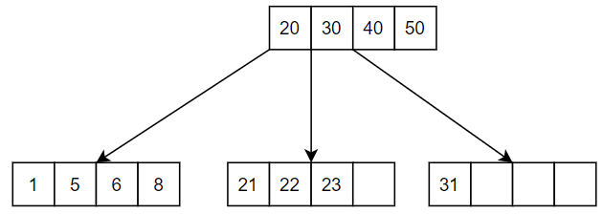
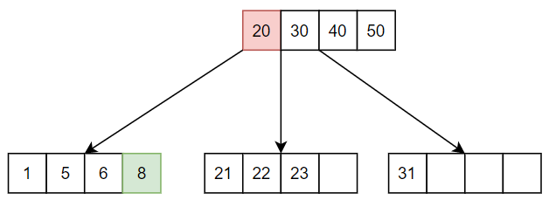
Variation of B-Tree (Redistribution)
GREEN => PROMOTED KEY
BLUE => INSERTED KEY
RED =>DEMOTED PARENT KEY
2
Source: File Structures (Second Edition) by Folk, Zoellick

Slide 32

Variation of B-Tree (Redistribution)
GREEN => PROMOTED KEY
BLUE => INSERTED KEY
RED =>DEMOTED PARENT KEY
2
Source: File Structures (Second Edition) by Folk, Zoellick

Slide 33
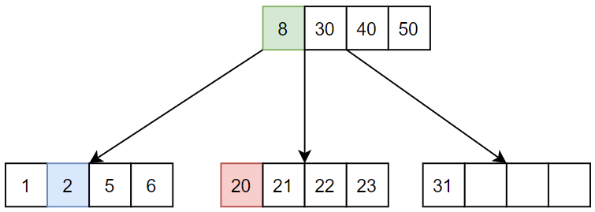
Variation of B-Tree (Redistribution)
GREEN => PROMOTED KEY
BLUE => INSERTED KEY
RED =>DEMOTED PARENT KEY
2
Source: File Structures (Second Edition) by Folk, Zoellick

Slide 34
Variation of B-Tree (Redistribution)
GREEN => PROMOTED KEY
BLUE => INSERTED KEY
RED =>DEMOTED PARENT KEY
FULL
3 OR 24
FULL
FULL
Source: File Structures (Second Edition) by Folk, Zoellick

Slide 35
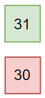
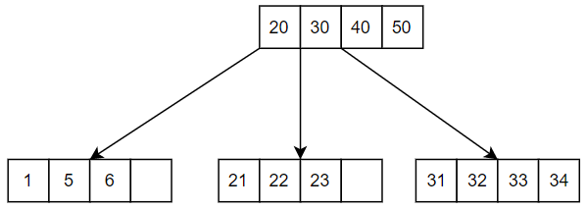
Variation of B-Tree (Redistribution)
GREEN => PROMOTED KEY
BLUE => INSERTED KEY
RED =>DEMOTED PARENT KEY
35
Source: File Structures (Second Edition) by Folk, Zoellick

Slide 36
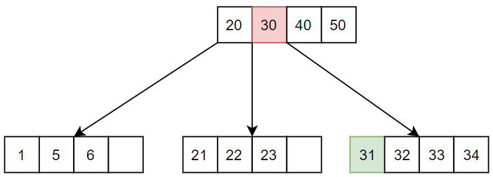
Variation of B-Tree (Redistribution)
GREEN => PROMOTED KEY
BLUE => INSERTED KEY
RED =>DEMOTED PARENT KEY
35
Source: File Structures (Second Edition) by Folk, Zoellick

Slide 37
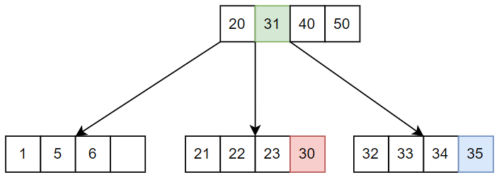
Variation of B-Tree (Redistribution)
GREEN => PROMOTED KEY
BLUE => INSERTED KEY
RED =>DEMOTED PARENT KEY
35
Source: File Structures (Second Edition) by Folk, Zoellick

Slide 38
Variation of B-Tree
B+ Tree and B* Tree
All data pointers are stored in the leaf nodes
Internal nodes are for navigation
All leaf nodes are connected through linked list

Slide 39
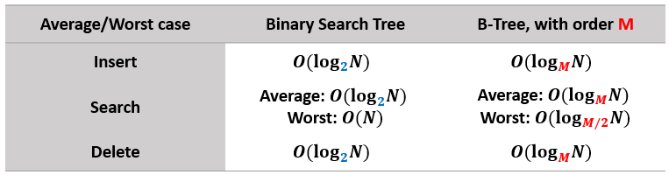
Efficiency Analysis: Time Complexity
When the order of B-Tree increases,
More elements can be stored per page
Overall tree height decreases
Number of steps for the search procedure decreases as the depth decreases
Therefore, search efficiency improves.
Remember, we want our B-Trees to be broad and shallow, instead of narrow and deep.

Slide 40





THE END
Thank you for listening!
Presented by:
Hannah Labana
Ivan Woogue
Marc Valeros
Wayne Dayata

